Slide 1
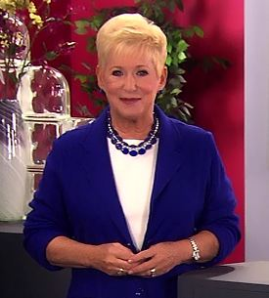
Killer Words of Customer Service

Slide 2
You Will Learn:
Telephone Doctor’s Eight Killer Words of Customer Service.
Effective replacement words or techniques to eliminate these Killer Words.
To enhance your communication skills with your company’s customers and prospects.
To become skilled at how to defuse daily challenges instead of escalating them.

Slide 3
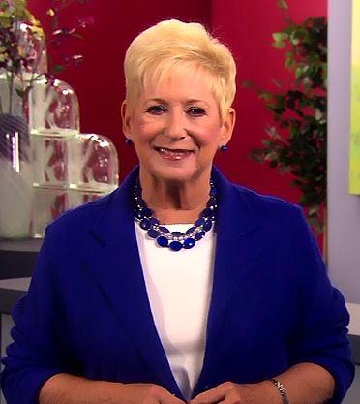
View
Program

Slide 4
Key Point #1:
Calm Down

Slide 5
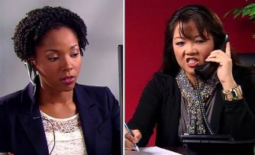
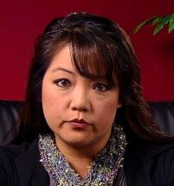
Discuss
In a business situation, why is it ineffective to tell a customer to calm down?
What are a few of the responses you would likely offer when you’re frustrated and someone tells you to “CALM DOWN?”
What does the phrase: “Life is a series of roles” mean?
In the program, Jessica sidetracked the conversation by telling the customer to calm down. Why is that like throwing gasoline on a fire?

Slide 6
Telephone Doctor® Prescription
Expect the opposite to happen.
Customers don’t like being told to “Calm Down.”
Focus effort on solving the problem.

Slide 7
Key Point #2:
Can I Be Honest With You?

Slide 8
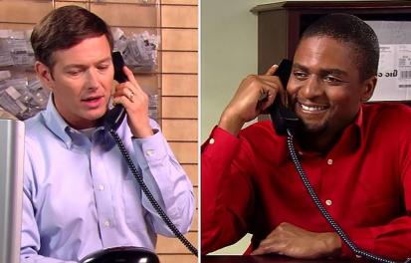
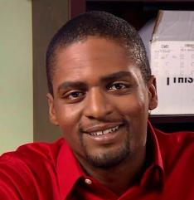
Discuss
What are the ramifications of saying to a customer: “Can I be honest with you?”
What are similar frustrating responses as: “Can I be honest…” which we should eliminate?
Is there ever an appropriate time when it’s okay to use these killer words?

Slide 9
Telephone Doctor® Prescription
Avoid this common credibility buster.
Considered social noise.
Customers expect the truth.

Slide 10
Key Point #3:
No Problem

Slide 11
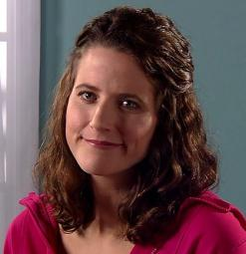
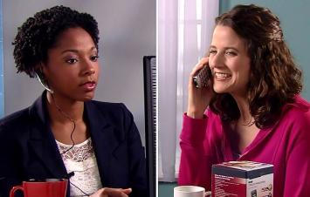
Discuss
Where did the killer words “No Problem” and “No Worries” originally come from?
Why do some people find these words offensive?
What words can replace these killer words?
When customers appreciate the service they’ve received and say “Thank you” it’s okay for customer service representatives to respond back by saying “No problem, that’s my job.” Is this accurate? True or False

Slide 12
Telephone Doctor® Prescription
“No problem” is perceived as dismissive to customers.
“You’re Welcome” is the gold standard for customer service providers.

Slide 13
Key Point #4:
Our Computers Are Slow

Slide 14
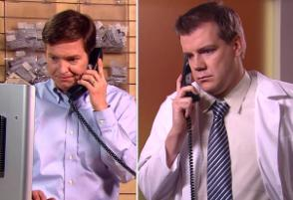
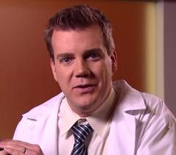
Discuss
What mental pictures are created when you hear these words?
Name a few of the occasional drawbacks/challenges at your organization.
Why does telling the truth to a customer regarding operational problems serve no purpose?

Slide 15
Telephone Doctor® Prescription
There is no value in sharing negative information.
Offer solutions not excuses.

Slide 16
Key Point #5:
What’s Your Name Again?

Slide 17
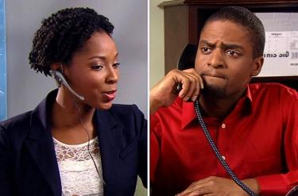
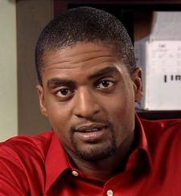
Discuss
Why do people sometimes ask these killer words: “What’s your name again?”
What are the four steps recommended, which are ‘less abrasive’ to get a name – when you’ve missed it?
What are similar killer words we’ve heard that are just as abrasive?

Slide 18
Telephone Doctor® Prescription
When you’ve missed the name, regroup.
Apply the four step technique to smoothly gather the name.
Acknowledge Request
Apologize
Tell the Truth
Reintroduce Yourself and Politely Gather Name

Slide 19
Key Point #6:
Yes, BUT…

Slide 20
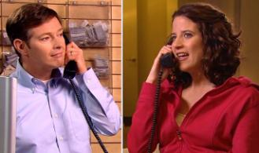
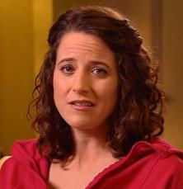
Discuss
In the customer service world the word “BUT” is thought of as the BIG ERASER. What do customers think when this killer word is said?
Why does the Telephone Doctor call these killer words: “Yes, BUT…” – THE TWO STAGE NO?
Name a few buffer phrases, which will smooth/soften our verbiage and replace “Yes, but…”

Slide 21
Telephone Doctor® Prescription
State the customer’s options.
Avoid this “Two Stage No.”

Slide 22
Key Point #7:
Sorry, That’s Our Policy.

Slide 23
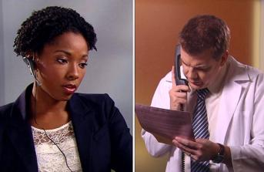
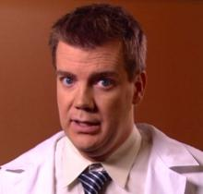
Discuss
We’ve all heard it! Think back to an experience when you were told by a business, “Sorry, That’s our policy.” How did you feel?
In most cases, an employee is simply stating a policy, rules or regulations as an explanation. So what’s wrong with restating company information back to your customers?
What other forms of “Sorry, That’s our policy” also alienate customers?

Slide 24
Telephone Doctor® Prescription
Customers aren’t interested in your company’s policies.
Look for solutions to the problems.
Exceptions can sometimes be made to prevent alienating customers.

Slide 25
Key Point #8:
You Don’t Understand

Slide 26
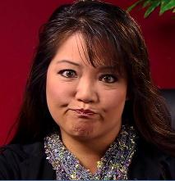
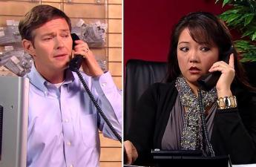
Discuss
What are some of the reasons customers don’t understand directions offered by employees?
Why isn’t it effective to repeat the same directions over again to a customer that doesn’t understand?
What can you say to bridge the communication gap and replace these killer words?

Slide 27
Telephone Doctor® Prescription
It’s our job to explain better.
Simplify the information and take responsibility.

Slide 28
SUMMARY OF KEY POINTS
Calm Down Expect the opposite to happen. Customers don’t like being told to “Calm Down.” Focus effort on solving the problem.
Can I Be Honest With You? Avoid this common credibility buster. Considered social noise. Customers expect the truth.
No Problem Is perceived as dismissive to customers. “You’re welcome” is the gold standard for customer service providers.
Our Computers Are Slow There is no value in sharing negatives. Offer solutions not excuses.
What’s Your Name Again? When you’ve missed the name, regroup. Apply the four step technique to smoothly collect the name.
Yes, But… Customers know something negative is coming next. Avoid this “Two Stage No.”
Sorry, That’s Our Policy Customers aren’t interested in our policies. Look for solutions to the problems.
You Don’t Understand It’s our job to explain better. Simplify the information and take responsibility.

Slide 29
Killer Words of Customer Service

